Slide 1
ESC101: Fundamentals of Computing
Basics of C Syntax,
Printing Outputs (printf)
Nisheeth

Slide 2
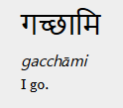
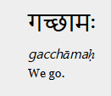
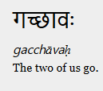
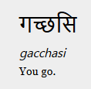
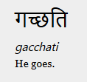
Syntax
The rules that decide how to combine symbols to form sentences
Subject-verb-object (SVO) languages, e.g. English, write sentences like, “the subject performed some verb upon the object”
Subject-object-verb (SOV) languages, e.g. Hindi, write sentences like, “subject ne object par kuchh verb kiya”

Slide 3



Syntax vs. standard
If violating a rule makes the sentence nonsensical, you have violated a syntactic rule
If violating a rule makes the sentence look unconventional, but still understandable, you have violated a standard

Slide 4
Syntax vs. standard
main() vs int main()
Some compilers will accept just using main, some will not
Some compilers will accept main functions that don’t have a return statement
We will follow the C11 standard in this course
Has been superseded by the C18 standard, but differences are minor and don’t show up in the material covered in this course
We may sometimes ask you questions for which the answer would be ‘depends on the compiler version’

Slide 5
C Syntax: The “Alphabet” of C
C programs can be written using the following alphabet
A B .... Z
a b .... z
0 1 .... 9
Space . , : ; ‘ $ “
# % & ! _ { } [ ] ( ) |
+ - * / =

Slide 6
C Syntax: Variables and Constants
Most C programs consist of variables or constants with some name
The value of each variables or constant is stored at some location in the computer’s main memory (RAM)
A variable’s value can be changed during execution of the program
A constant’s value cannot be changed during execution of the program
More on naming conventions/rules later
firstName, age, height, streetAddress, valueOfPi

Slide 7
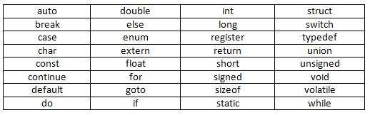
C Syntax: C Keywords (root words)
Seen so far
C language has a set of 32 keywords
These keywords have special meaning
Can’t use keywords for other purposes (e.g., can’t use them to declare variable names, constant values, or function names)
Prutor shows keywords in a different color

Slide 8
C Syntax: Keywords Usage
# include <stdio.h>
int main(){
int main = 3;
printf(“%d”, main);
return 0;
}
# include <stdio.h>
int main(){
int return = 3;
printf(“%d”, return);
return 0;
}
This WILL work
Reason: main is not a keyword
But not recommended
This will NOT work
Reason: return is a keyword

Slide 9



Advice: Try to Write Code that looks good
Very important in industry - large groups collaborate
Important even for solo projects - maintenance
Will learn several good coding habits over time (such as Commenting, Indentation, Code-structuring)
#include<stdio.h>
int main(){
int a = 1;
int b = 2;
int c;
c = a + b;
printf(“Result is %d”,c);
return 0;
}
#include<stdio.h>
int main(){
int a = 1;
int b = 2;
int c;
c = a + b;
printf(“Result is %d”,c);
return 0;
}
#include<stdio.h>
int main(){
int a = 1;
int b = 2;
int c;
c = a + b;
printf(“Result is %d”,c);
return 0;
}
Prutor does it automatically when you write your code
(try writing code in Prutor)
This is good indentation

Slide 10
The printf Function
A function used for printing the outputs of the C program
Prints the outputs in a format specified by us
We have already seen some simple examples of usage of printf
printf(“Welcome to ESC101”);
printf(“Result is %d”, c);
%d is used to print the value of an integer
An integer

Slide 11
Introducing Mr. C (or Mr. Compiler)
Will sometimes use this fictional character to refer to the C compiler (or our Prutor system)
Sometimes it will mean the screen of the computer that shows us the program’s output

Slide 12
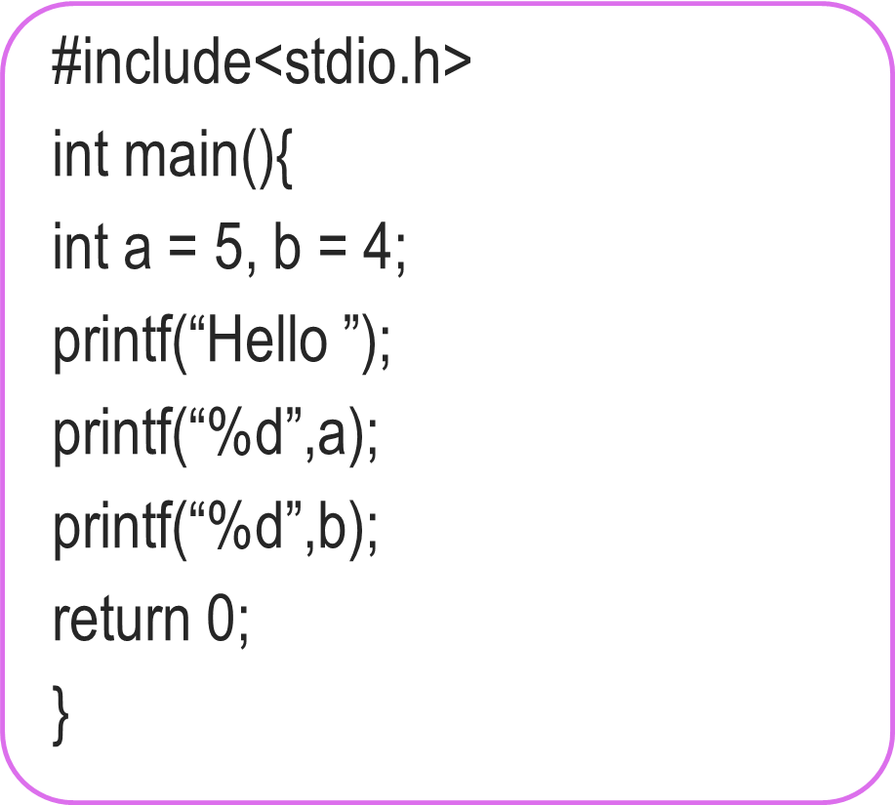


True Power of printf
We have seen how to make Mr. C
Say things like “Welcome to ESC101”
Tell us the value of an integer variable
Don’t be afraid to experiment
#include<stdio.h>
int main(){
int a = 5, b = 4;
printf(“Hello”);
printf(“%d”,a);
printf(“%d”,b);
return 0;
}
No, you can make him speak again and again
Can he speak only once?
Hello54
Hello 54

Slide 13
True Power of printf
We have seen how to make Mr. C
Say things like “Welcome to ESC101”
Tell us the value of an integer variable
Okay, lets see in detail
I am confused ☹
#include<stdio.h>
int main(){
int a = 5, b = 4;
printf(“Hello %d %d”,a,b);
return 0;
}
Yes, very powerful ones!
Any shorthands?
Hello 5 4

Slide 14
How printf Works?
How we must speak to mr. compiler
How we usually speak to a human
printf(“Hello %d %d”,a,b);
Please write the English word Hello, followed by a space, followed by the value of an integer, followed by a space followed by the value of another integer.
By the way, the first integer to be written is a and the second integer to be written is b.
Format string
Format string tells me how to print things, and then I am told what to print
Mr. C likes to be told beforehand what all we are going to ask him to do!
printf follows this exact same rule while telling Mr. C what to print

Slide 15

True Power of printf
Can also use printf to directly print the value of an expression
int main(){
int a = 3;
int b = 2;
printf(“Sum of a and b = %d”, a+b);
return 0;
}

Slide 16
Summary: The syntax of printf
Note: In some cases,
there will be no such list.
Example: printf(“Hello”);
printf(format string, list of things to print);
Example (already seen)
printf(“Hello %d %d”, a,b);
Important: Format string must have format specifiers for all things we wish to print in the exact same order as those things appear in the list of things
Can Mr. C print integers only?
Of course NOT.
Wait for next week’s lectures

Slide 17
Some Fun with printf
If I see \n, I will start printing on a new line
Can I print different things on separate lines?
What if I wish to print the character “ (inverted quotes)?
What if I wish to print the character % (percentage sign)?
Hello
5
4
printf(“Hello\n%d\n%d”,a,b);
printf(“\“Hello\““);
If I see \”, I will print “
“Hello”
If I see %%, I will print %
printf(“90%% marks“);
90% marks

Slide 18
Some Fun with printf
To print on new line, use \n
To print the character \ (backslash) use \\
To print a tab character (a longer space) use \t
Allows us to print very nicely formatted output ☺
More examples in labs – till then, have fun on your own
printf(“To print on new line, use \\n”);
\n, \” called escape sequences since they “escape” the normal rules
printf(“Very\tNice“);
Very Nice
Experiment with them to get comfortable

Slide 19

Fun with Integers
Operation | C Code | a | b | c
Addition | c = a + b; | 5 | 4 | 9
Subtraction | c = a – b; | 4 | 5 | -1
Multiplication | c = a * b; | -2 | -4 | 8
Division | c = a / b; | 7 | 2 | 3
Remainder | c = a % b; | 7 | 2 | 1
Be careful: in math we often write z = 2xy
Mr C will not like it.
He will want z = 2 * x * y;
Also be careful about division and remainder
7 / 2 is actually 3.5 but since c is an integer variable, it just stores 3. Remainder is 1
Experiment on your own – will revisit these very soon
Oh! So Mr. C allows us to use constants too in expressions?
Not everything needs to be stored in a variable
Yes. The command c = 2 + b;
makes sense to me
printf(“%d %d”,a,10);
is fine too ☺
Come to the lab and give it a try!

Slide 20
Life beyond Integers
Lots of fun possible with integers alone
However, the box storing integers is actually not very big
Can only store integers between -2,147,483,648 and 2,147,483,647
Also, what about real numbers (fractions etc)
How to ask Mr C to work with a real number?
How to ask Mr C to print a real number?
Later classes: long, float, double, long double
C designers were really nice with names

Slide 21
Emoticons from Flaticon, designed by Twitter
https://www.flaticon.com/packs/smileys-and-people-9 Licensed under CC BY 3.0

